Slide 1
NATURAL SELECTION
YEAR 10 BIOLOGY

Slide 2
TODAYS LESSON
WHAT: Learn about natural selection
WHY: To see how Darwin’s 5 points of natural selection provides evidence in support of the Theory of Evolution
HOW: Class discussion and notes in workbook

Slide 3
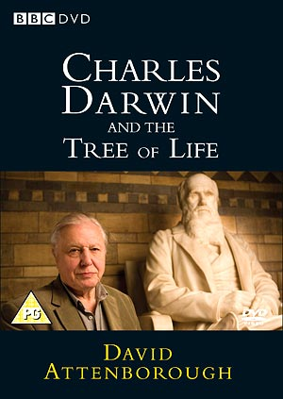
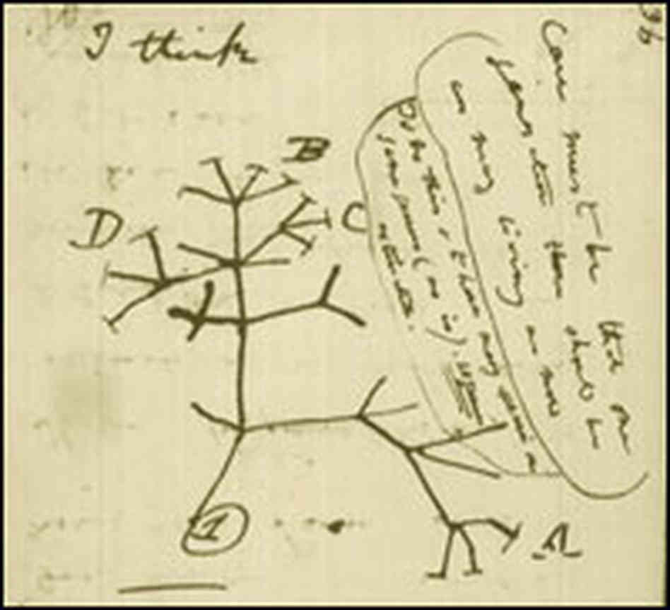
CHARLES DARWIN AND THE TREE OF LIFE DVD

Slide 4
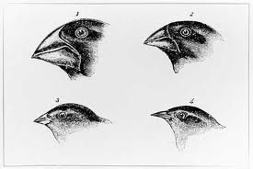
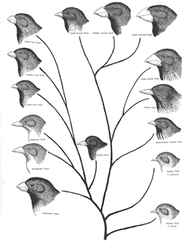
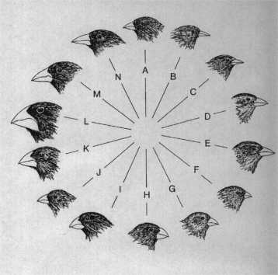

Slide 5
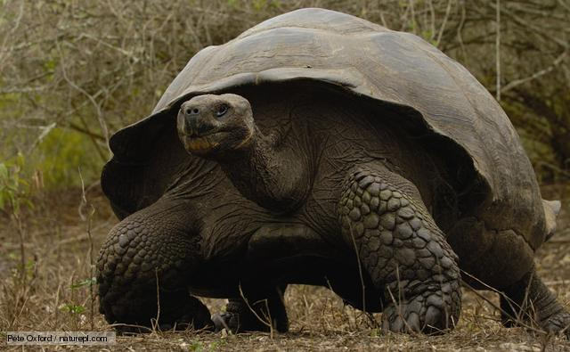
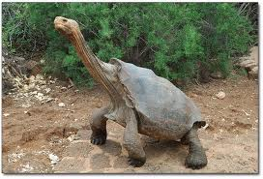
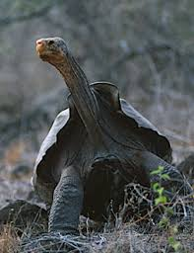
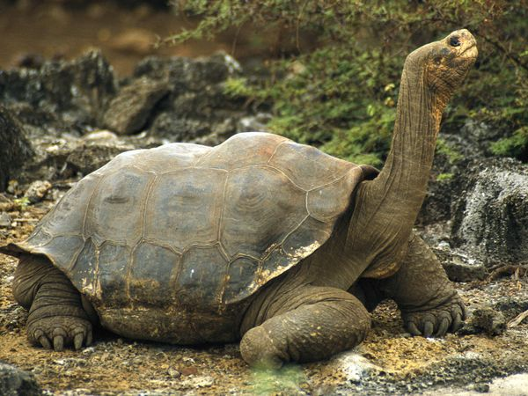

Slide 6
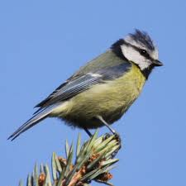
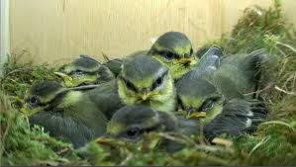
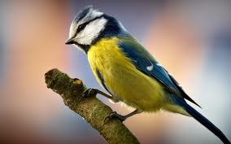
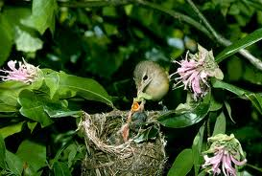

Slide 7
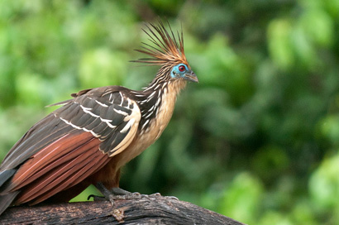
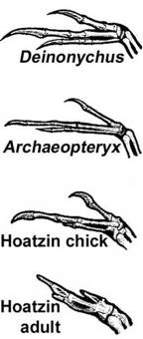
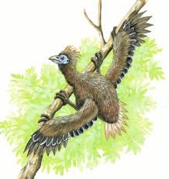

Slide 8
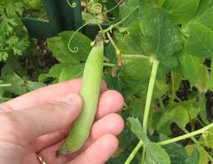
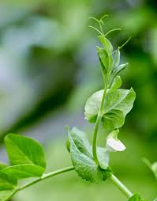
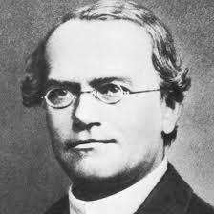

Slide 9
DARWINS 5 PRINCIPLES OF NATURAL SELECTION
Population has variations
Some variations are favorable
More offspring are produced than survive
Those that survive have favorable traits
A population will change over time

Slide 10
What has natural selection selected:
AGAINST? __________ FOR? _____________
Identify Darwin’s 5 points of natural selection in the scenarios
Population has variations
Some variations are favorable
More offspring are produced than survive
Those that survive have favorable traits.
A population will change over time.

Slide 11
QUESTION ONE
There are 2 types of worms: worms that eat at night (nocturnal) and worms that eat during the day (diurnal). The birds eat during the day and seem to be eating ONLY the diurnal worms. The nocturnal worms are in their burrows during this time. Each spring when the worms reproduce, they have about 500 babies but only 100 of these 500 ever become old enough to reproduce.

Slide 12
QUESTION TWO
There are 3 types of polar bears: ones with thick coats, ones with thin coats and ones with medium coats. It is fall, soon to be winter. The temperatures are dropping rapidly and the bears must be kept warm, or they will freeze to death. Many of the bears have had 2 cubs each but due to the extreme temperatures, many mothers only have one cub left.

Slide 13
QUESTION THREE
In ostriches, there are 2 types: ones that run fast and those that run slowly. The fast birds can reach up to 40 miles an hour. Jackals love to eat ostrich, and they can reach speeds of up to 35-40 miles per hour. A flock of ostrich will lay approximately 10 eggs (each mother only lays 1), but many rodents break into the eggs and eat the fetus before they hatch.

Slide 14
EVOLUTION UNIT PROJECT
THEORISTS WHO CONTRIBUTED TO THE THEORY OF EVOLUTION
Choose ONE of the main theorists whose work contributed to the Theory of Evolution. Write a 100 word biography outline who they were and how their work contributed
Charles Darwin Gregor Mendell
Richard Owen Francis Crick
Marie Curie James Watson
Alfred Wallace Alfred Wegener

Slide 15
EVOLUTION UNIT PROJECT
BIOGEOGRAPHY (MINIMUM 200 WORDS)
Up until the early 20th century Scientist were convinced that Earths continents were fixed in their locations. Alfred Wegener’s theory of continental drifting is a key piece of evidence that supports Charles Darwin’s Theory of Evolution. Research and describe plate tectonics and what evidence their existence provides in support of Darwin’s Theory of Evolution.
GOOGLE SEARCH KEYWORDS
Plate tectonics Alfred Wegener
The Origin of Continents and Oceans

Slide 16
EVOLUTION UNIT PROJECT
CHARLES DARWIN AND THE GALAPAGOS ISLANDS (MINIMUM 150 WORDS)
During his visit to the Galapagos Islands Charles Darwin observe the different physical traits of the Finches and Galapagos tortoises between the 16 islands. In your own words outline ONE of these different physical traits and what evidence they provided towards Darwin’s Theory of Evolution through Natural Selection

